Slide 1
Data Centers
UBMS Stem Experience: Jurassic Park
Notes:
Preload Videos:
Google Data Center: https://youtu.be/XZmGGAbHqa0?t=95
Microsoft Underwater Data Center: https://www.youtube.com/watch?v=LmfvUiJ6tB8&ab_channel=TechVision

Slide 2
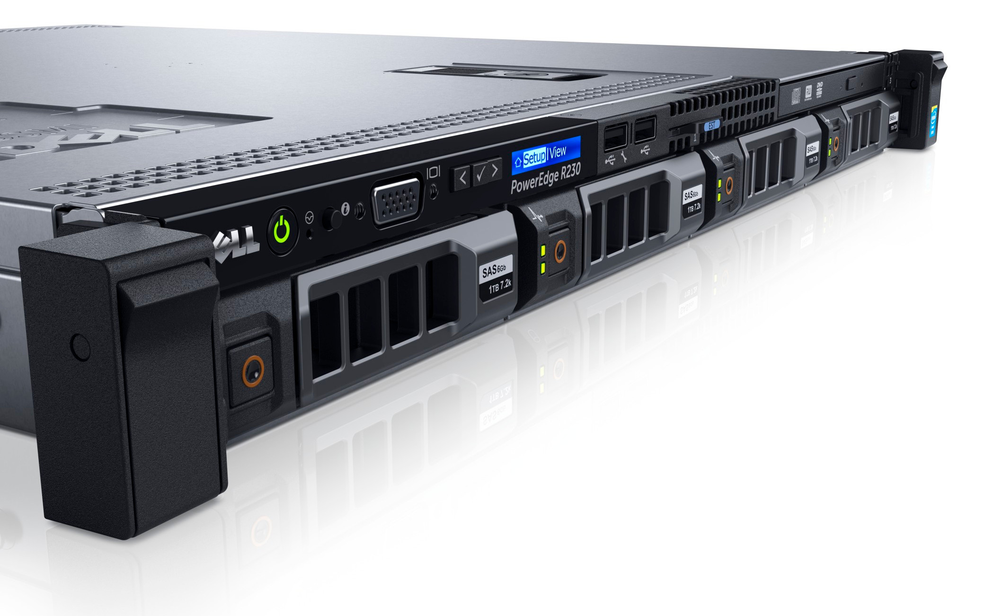
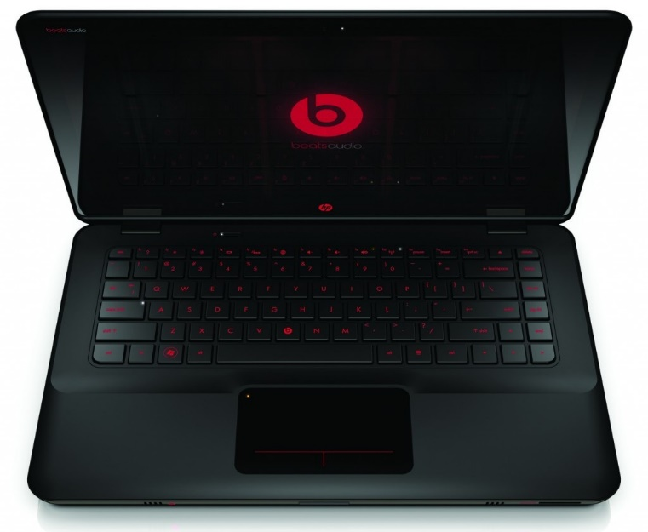
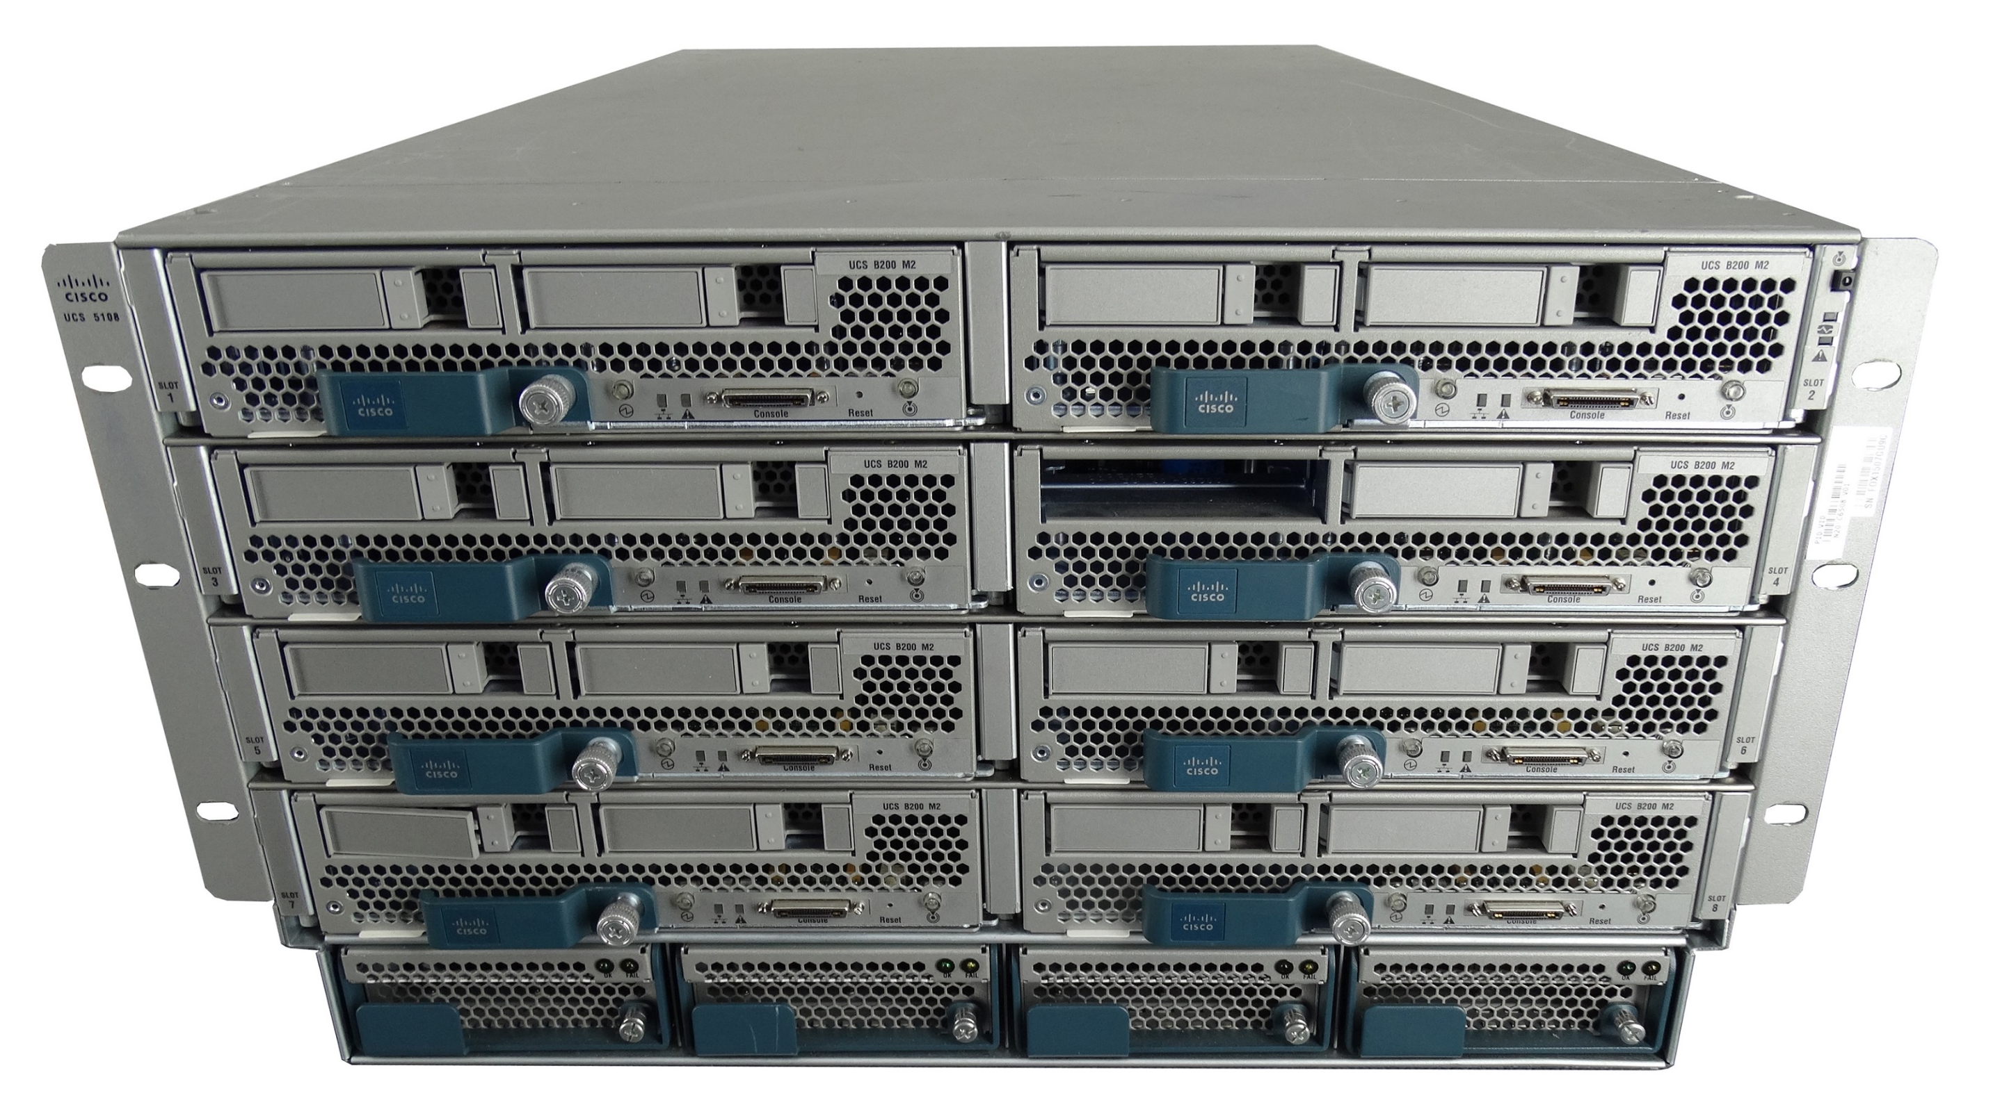
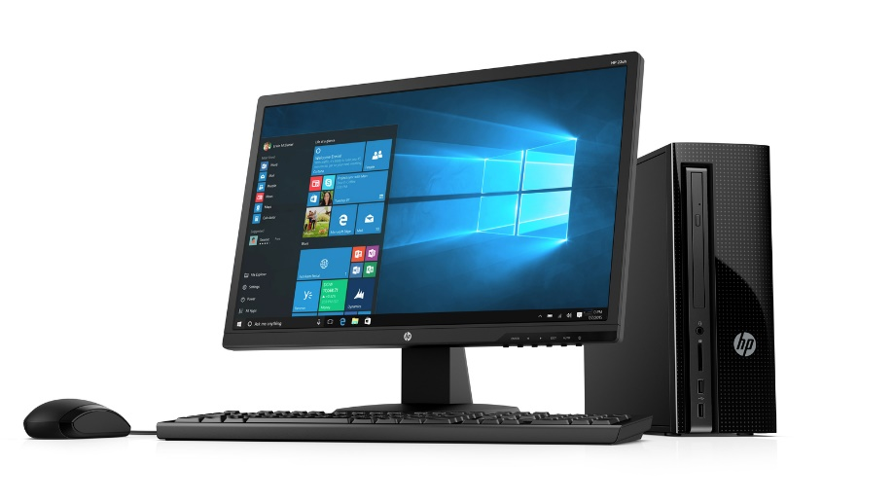
Remember:
Servers
Personal Computers
Notes:
When we think about a computer, perhaps the first thing that comes to mind is the traditional hardware that we are used to seeing everyday. That is, the normal desktop unit or the laptop and if you are more familiar with networking then we might also consider server hardware.

Slide 3
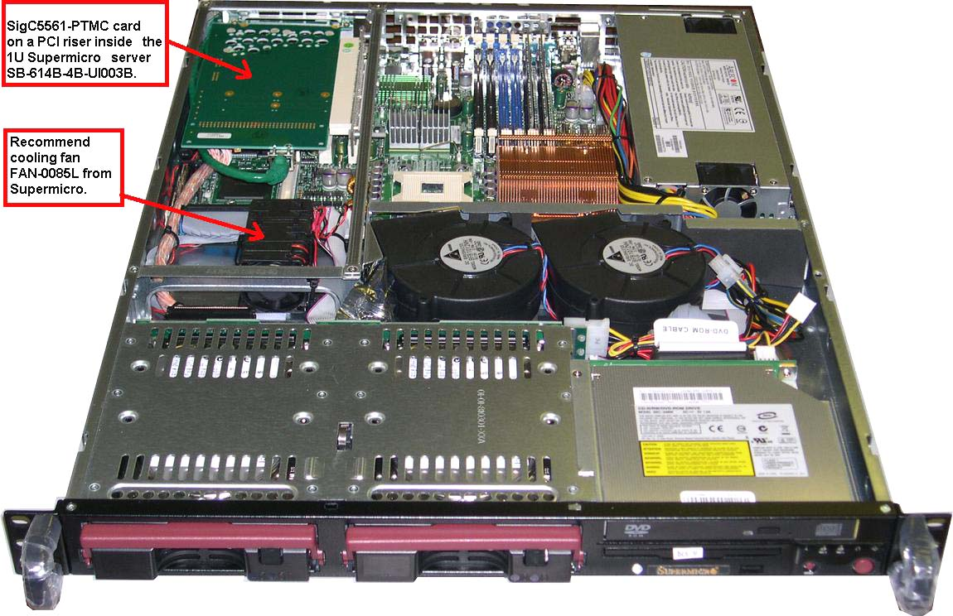
Inside Look

Slide 4
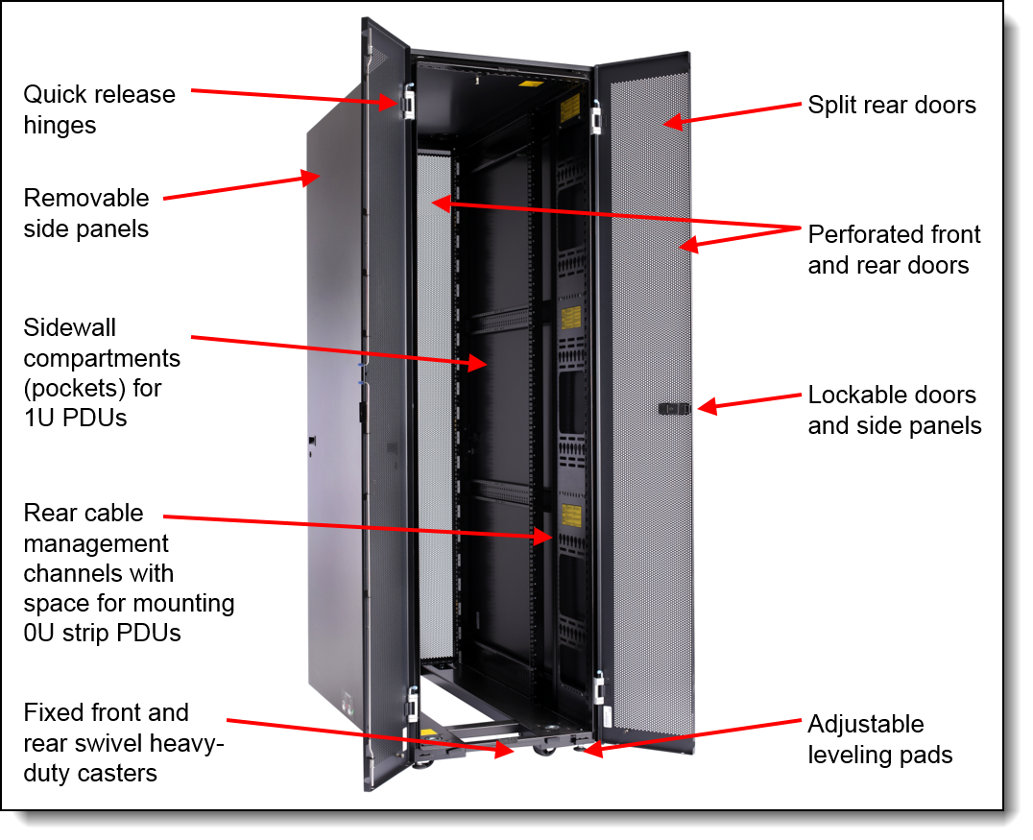
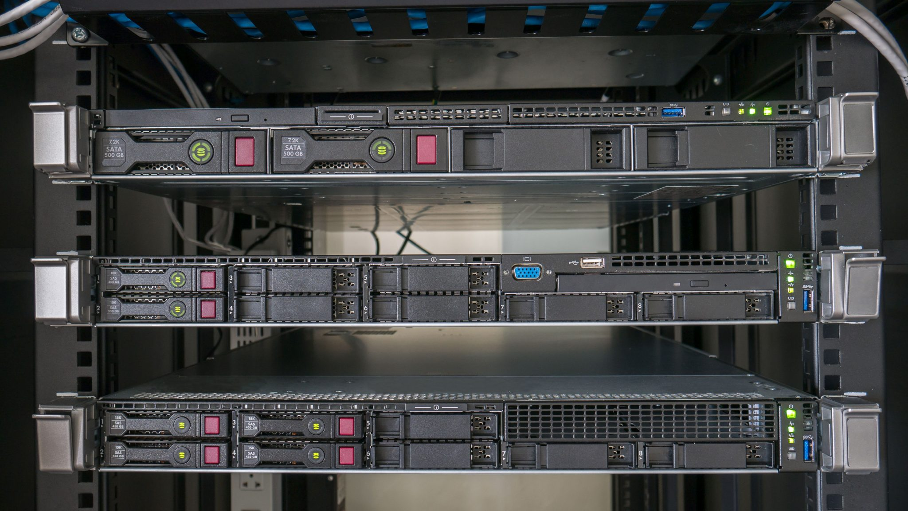

Slide 5
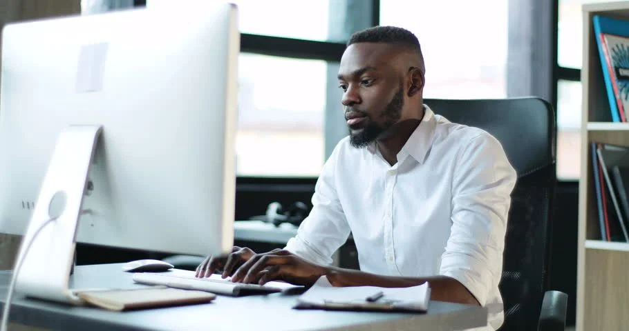
Seems Simple Enough

Slide 6
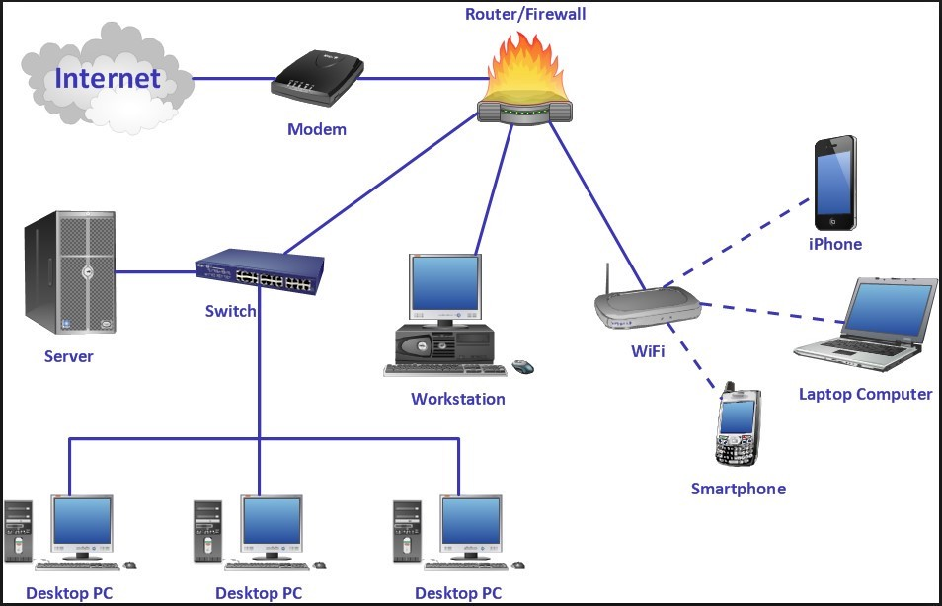
Networks

Slide 7
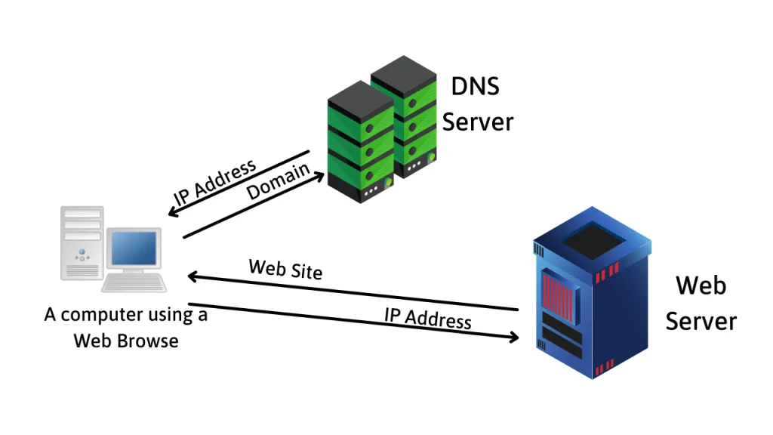
Servers

Slide 8
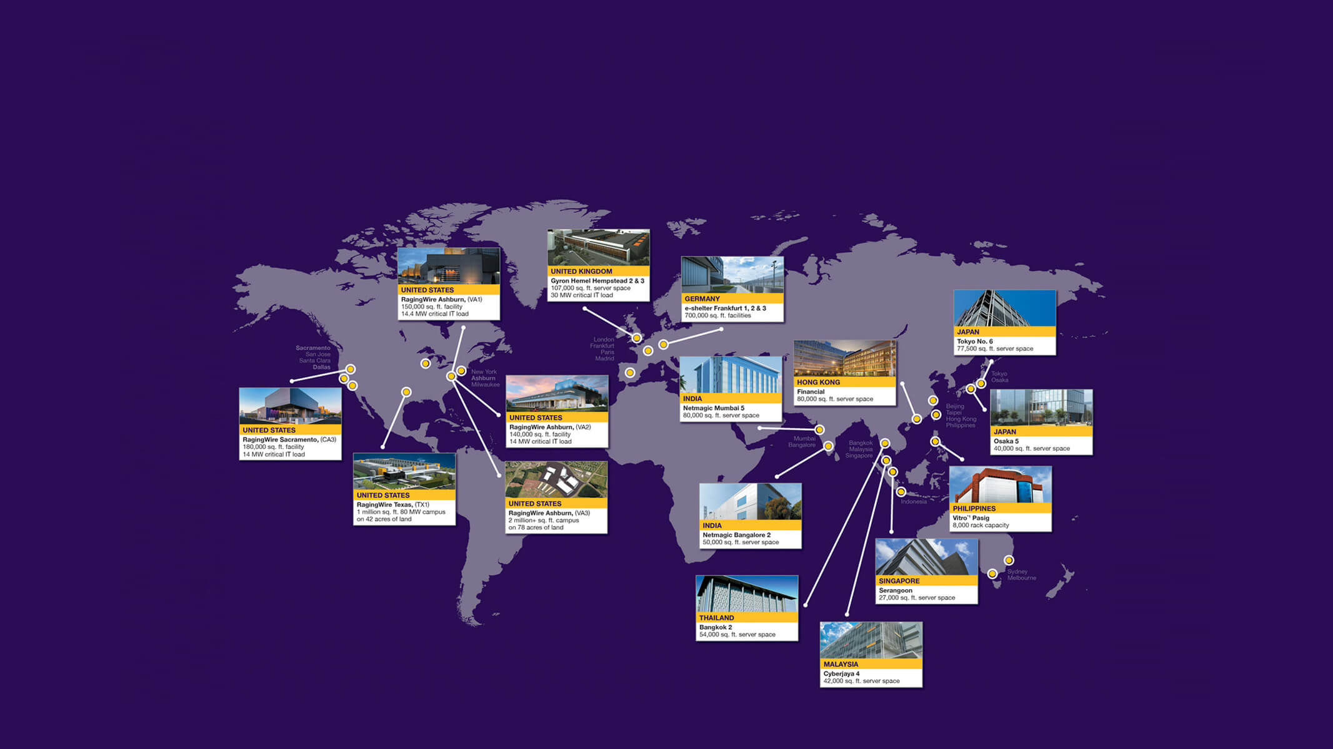
Data Centers Worldwide

Slide 9
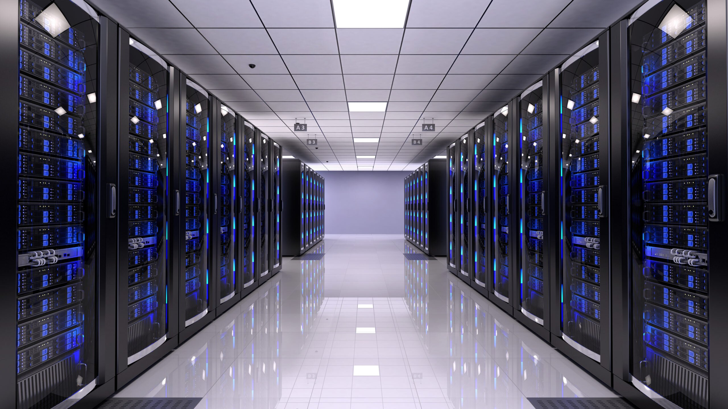
Data Center Aisles

Slide 10
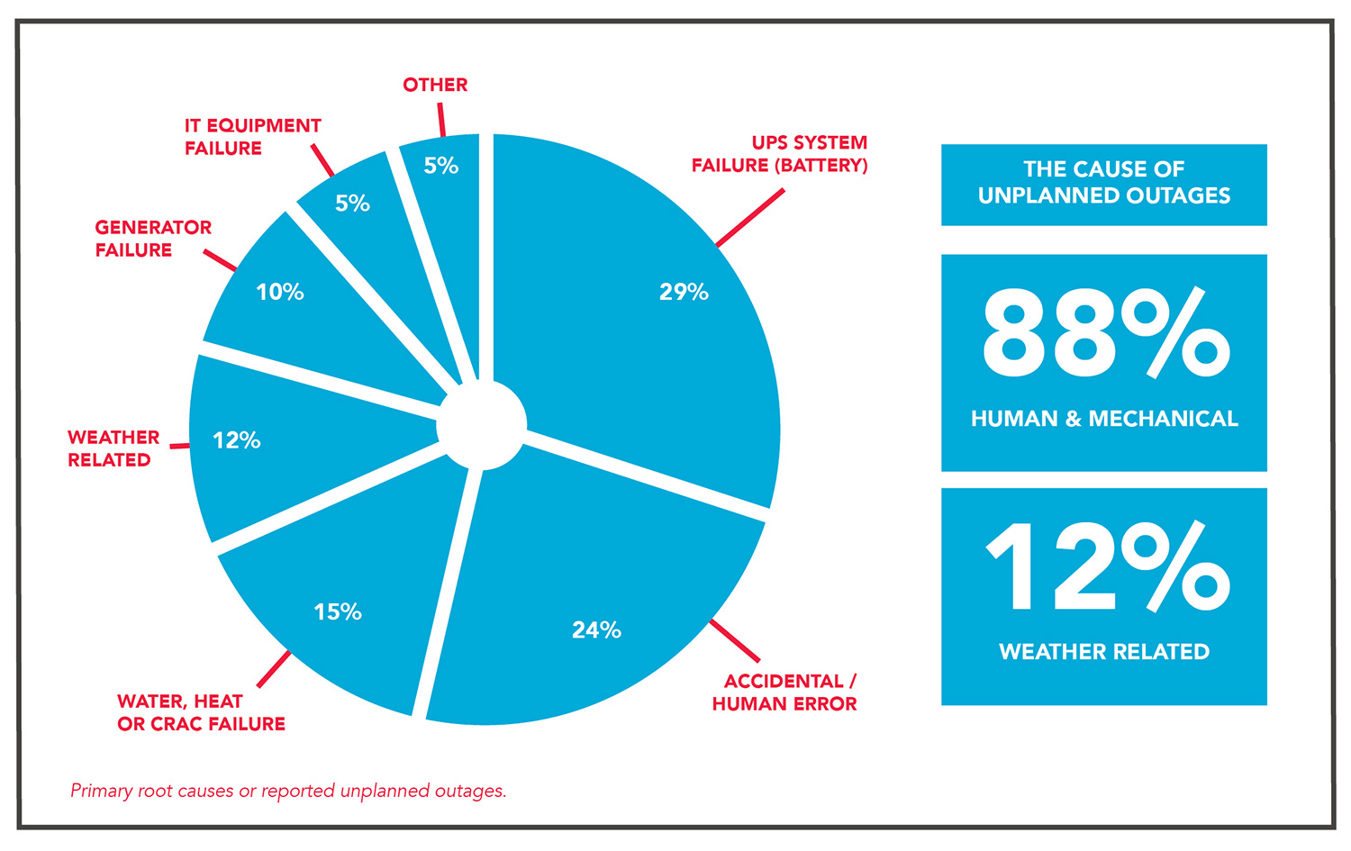
Data Center Downtime
https://downdetector.com/
https://www.isitdownrightnow.com/

Slide 11
Virtualization

Slide 12
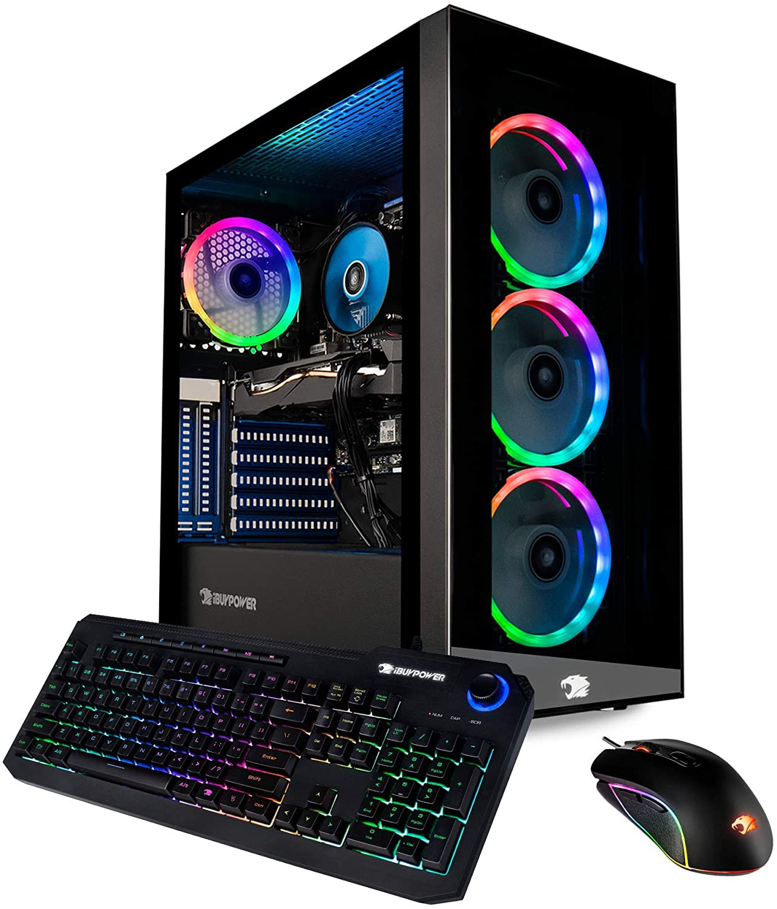
This is a computer
Case
CPU
RAM
Storage

Slide 13
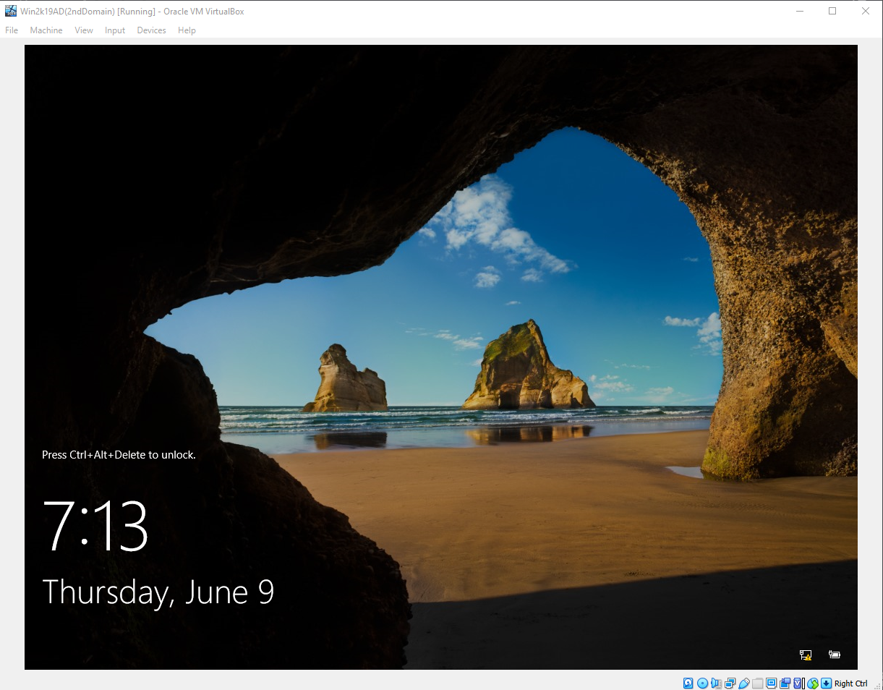
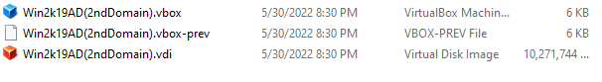
This is a virtual computer

Slide 14
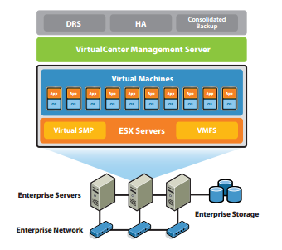
How does this work?
One or more servers have VMWare installed on them
This is called the Host OS
Servers can operate individually or as a cluster
Virtual Machines ’s (VM’s) are created in a host cluster
Inside the cluster, they are assigned to a physical server

